Slide 1

My Journey

Slide 2
Independent journey's

Slide 3
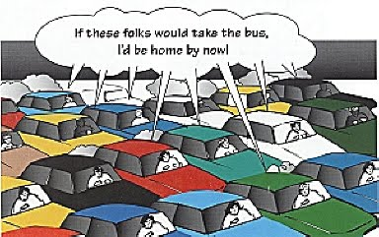

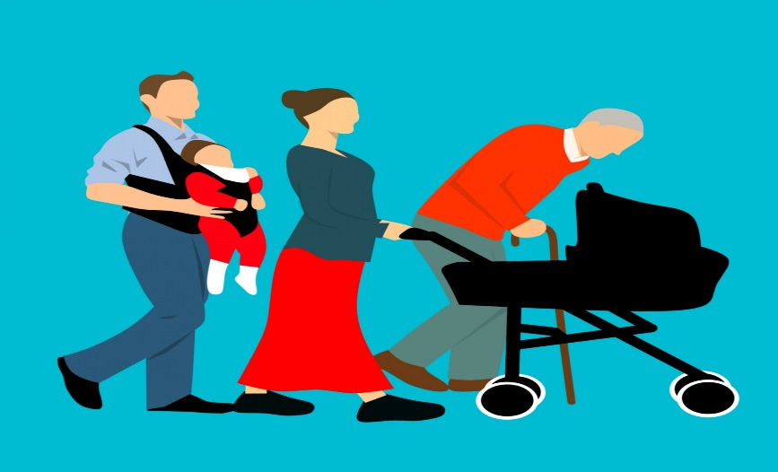
What things could change on each journey?
Traffic
Weather
Other pedestrians

Slide 4
Green Cross Code
Find a good place to cross
Stop
Look
Listen
Think

Slide 5




What could distract you while crossing the road?
Friends, mobile phones, music, loud noises, animals etc.
Remember you are responsible for keeping yourself safe.

Slide 6
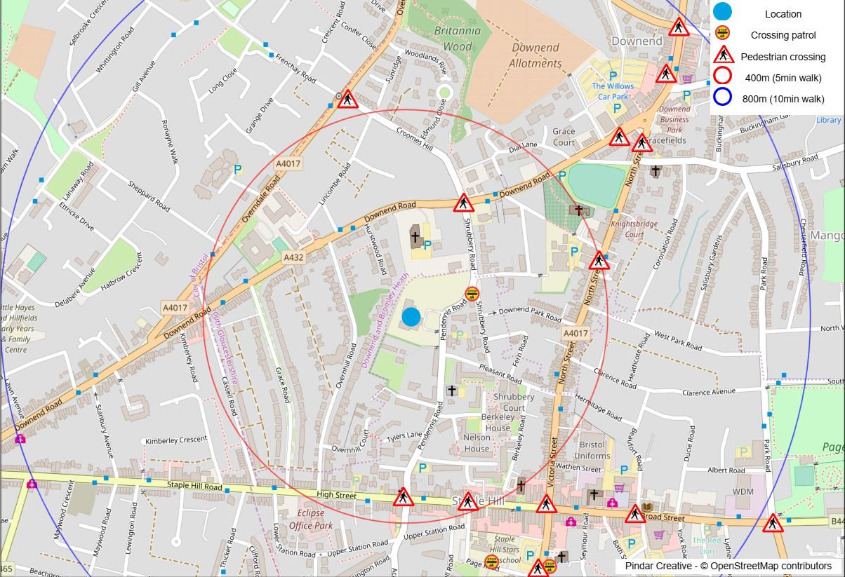

Slide 7
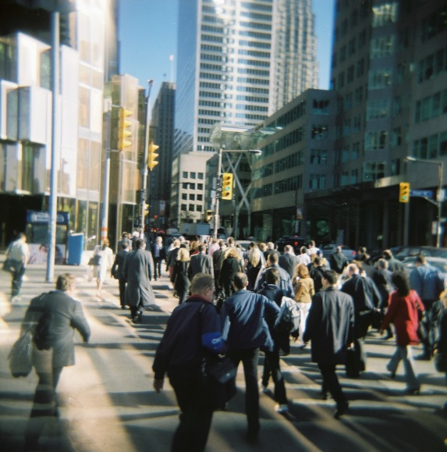
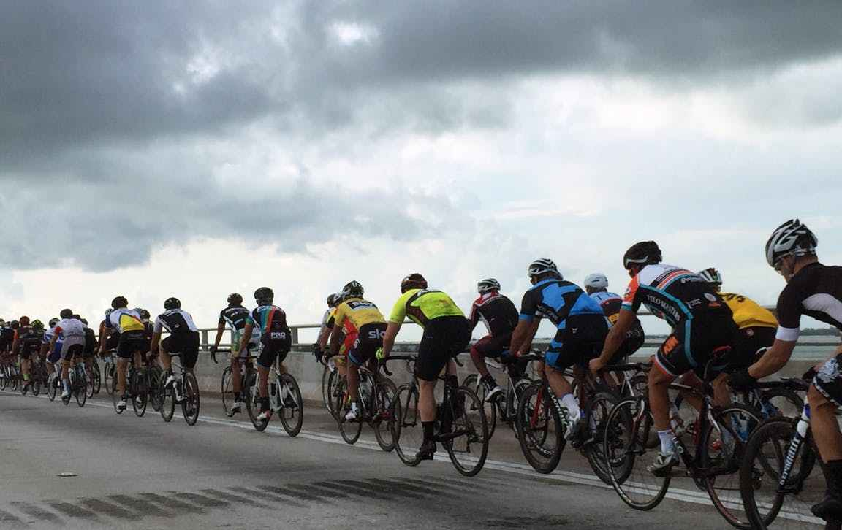
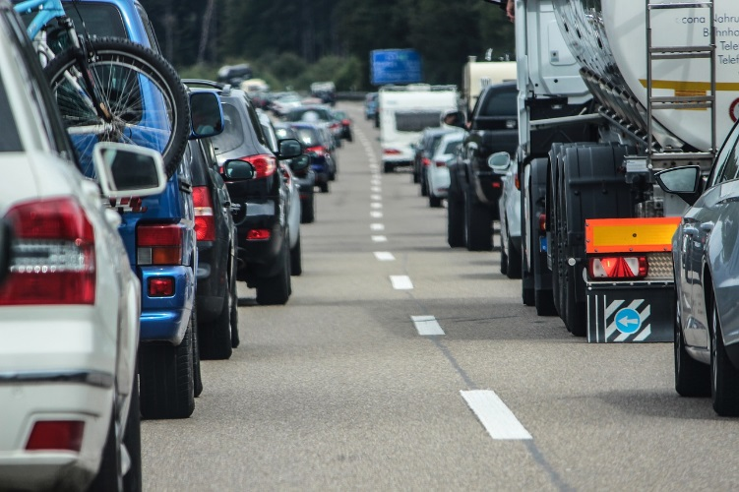
Who else might we encounter when out and about?
Pedestrians
Cyclists
vehicles

Slide 8
Does our journey affect others on their journey? If so how?
Good behaviour
Waiting before stepping out on a Zebra crossing
Crossing where you can see and be seen
Thinking of others if you are scooting on the pavement
Not good behaviour
Running across the road without checking first
Not giving others on the pavement room
Scooting or cycling on the pavement when there are lots of people

Slide 9
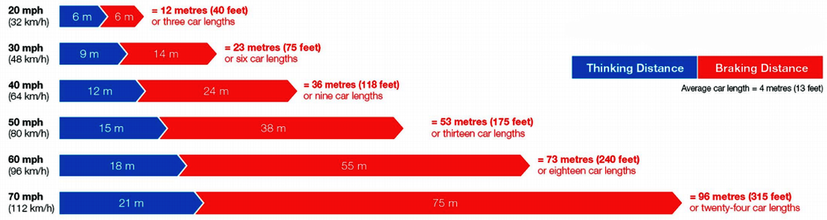
Stopping distances
These stopping distances are based on the best scenario. If the vehicle or the conditions are different the vehicle will take longer to stop. (weather, type of vehicle, condition of vehicle, focus of driver)

Slide 10
REMEMBER
You are responsible for keeping yourself safe.
Give drivers enough time to stop whenever you cross the road.

Slide 11
For more information please contact
South Gloucestershire Council
Road Safety
Tel: 01454 867802
Email: pre&primary@southglos.gov.uk

