Slide 1
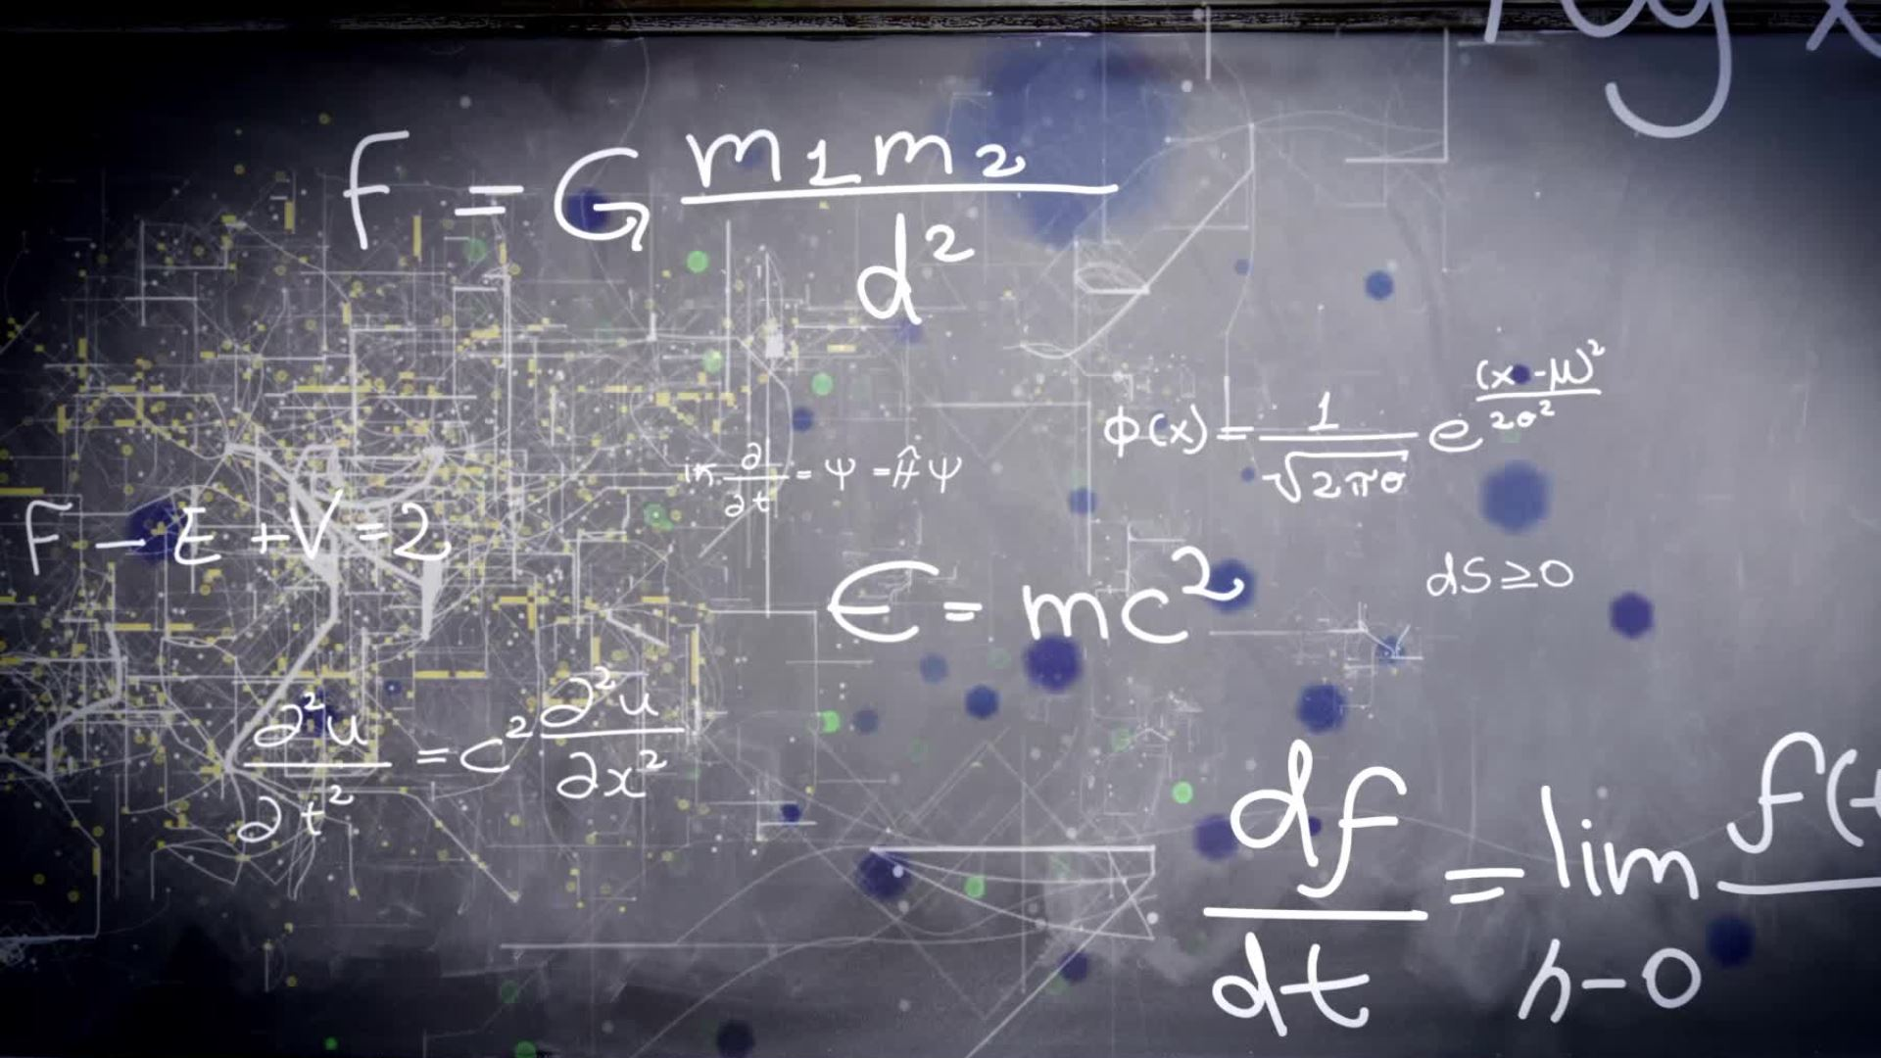
Maths at Blackhorse

Slide 2
When do we teach Maths and what does it look like?
Key Stage 1 teaches their Maths every morning.
Every session in Key Stage 1 (and 2) follows the same structure.
We have broken our curriculum into different blocks.
Each lesson also has the following sections -
Fluency
Varied fluency
Reasoning
Investigations

Slide 3

Modelling Maths
I do
We do
You do

Slide 4
Fluency
This is a crucial part of the journey.
Ensures children can complete the calculation efficiently and accurately before moving forward.
Gives children time to practise the same specific skill over and over again.
Revisited constantly

Slide 5
What is the crucial learning KS1 children leave Year 2 knowing?
Subitisation (EYFS)
Numbers to 100
Number bonds to 10
Number bonds to 20
Strategies for addition (2 digit + 2 digit)
Strategies for subtraction (2 digit – 2 digit)
2, 5 and 10 times tables

Slide 6
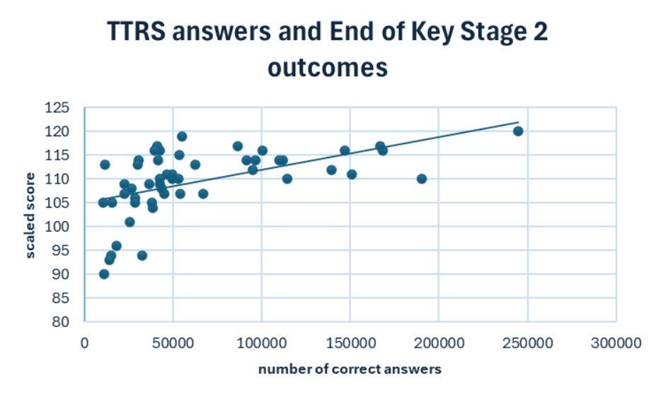

Slide 7
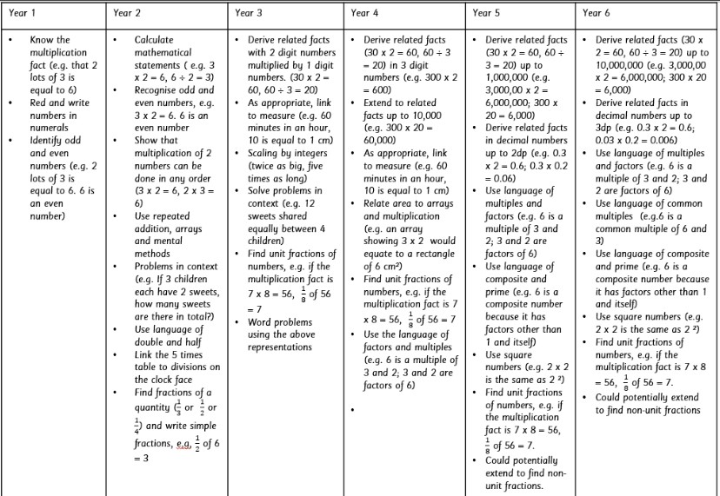
Support at home – times tables
39 objectives from Year 1 – 6 that relate to multiplication and division.
This doesn’t even include all of the problem solving and reasoning questions that will include times tables, money, time, decimals, area, perimeter etc.

Slide 8
Talking about Maths
Completing homework.
Asking what they are doing specifically in Maths at the moment.
Loads of free resources – just google the topic, the year group and reasoning about 1000's of great things will appear.
Talking positively about Maths at home.
  You wouldn't say I can't read.

Slide 9
We Do
8 + 7 =

Slide 10
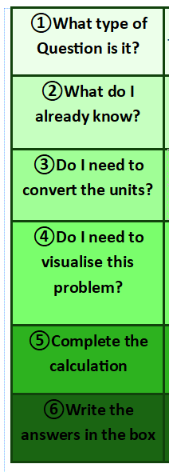

We Do
Mr Denton was baking cupcakes.
he baked 7 cupcakes then baked another 5 cupcakes.
How many cupcakes did he make all together?

Slide 11
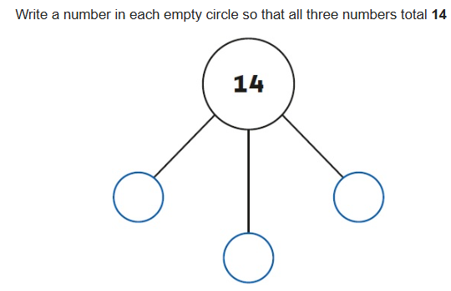
You do
9 + 6 =
Challenge

Slide 12
Real life Maths
Measuring distances
Shopping – four operations
Weight
Gardening
Cooking

